Slide 1
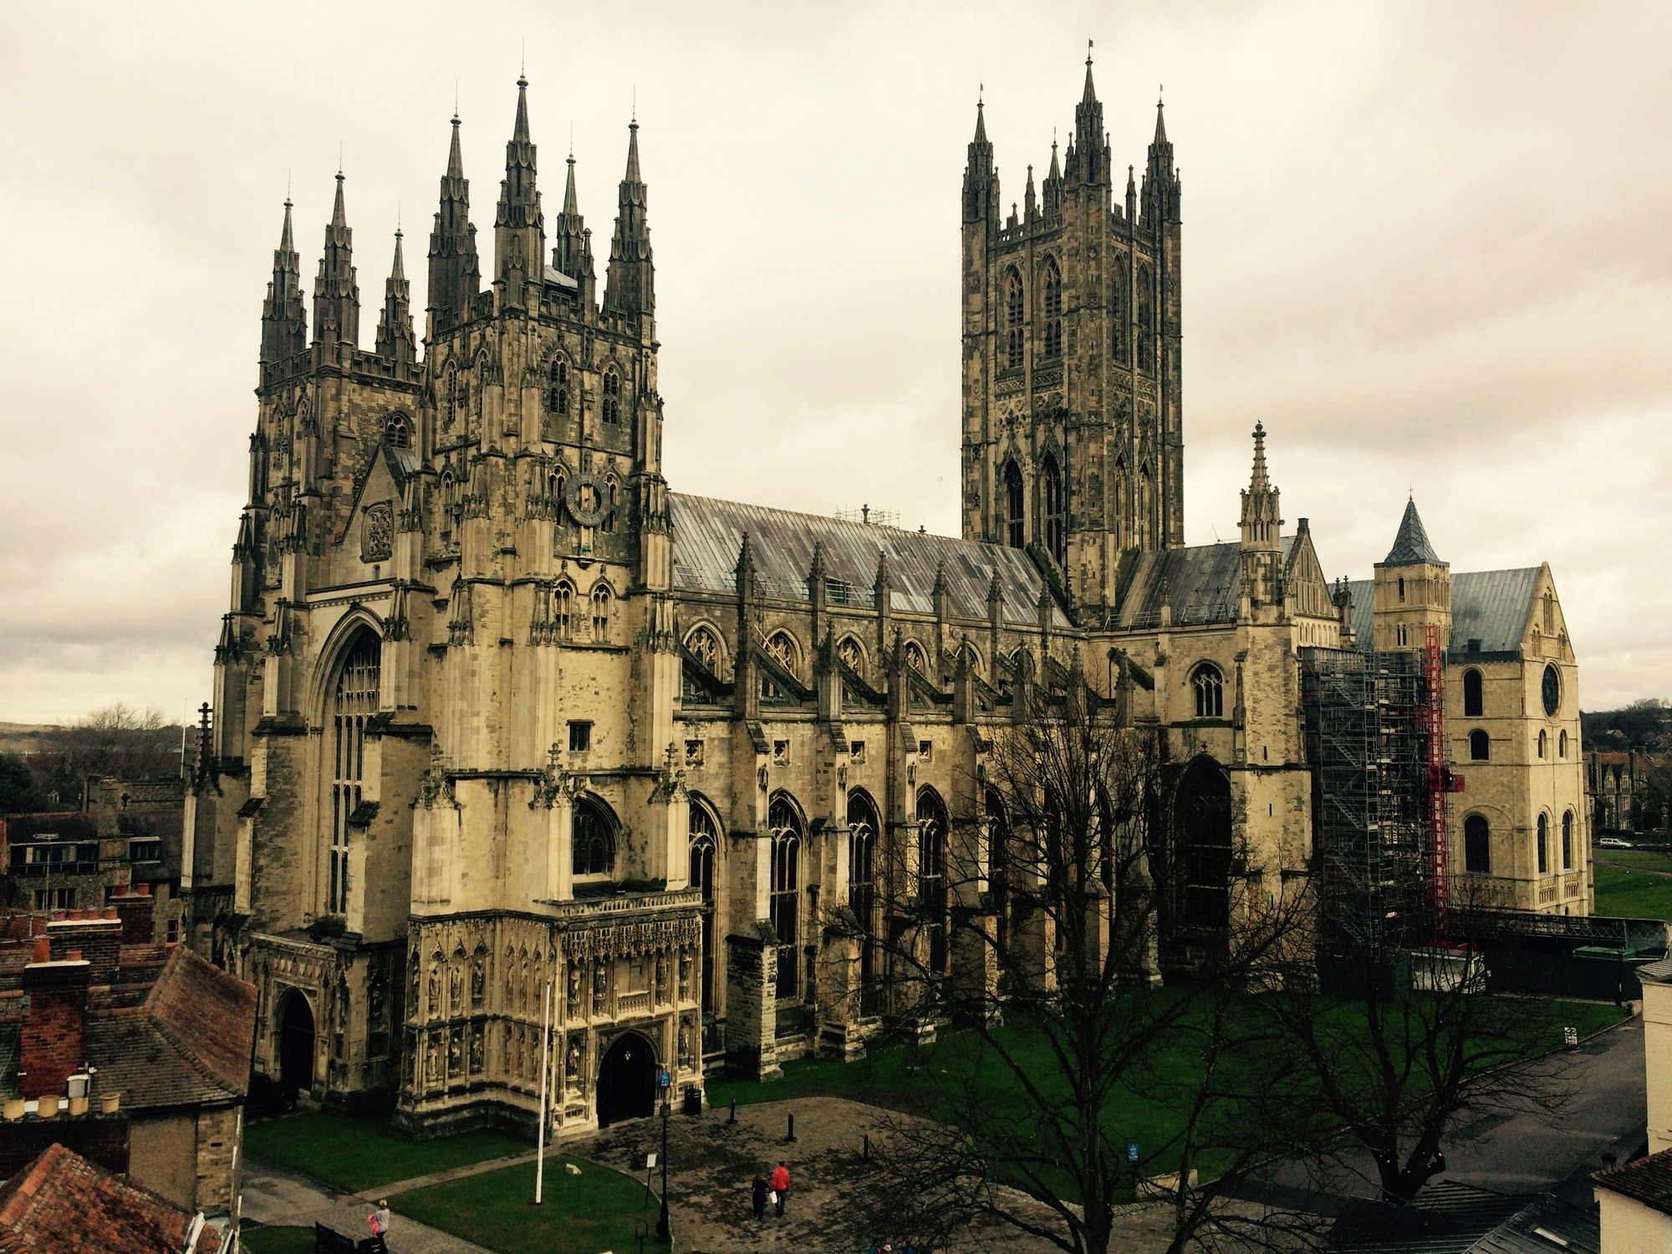
An incredible piece of British architecture
Canterbury Cathedral
Poluboyarinov Ivan B02-210

Slide 2
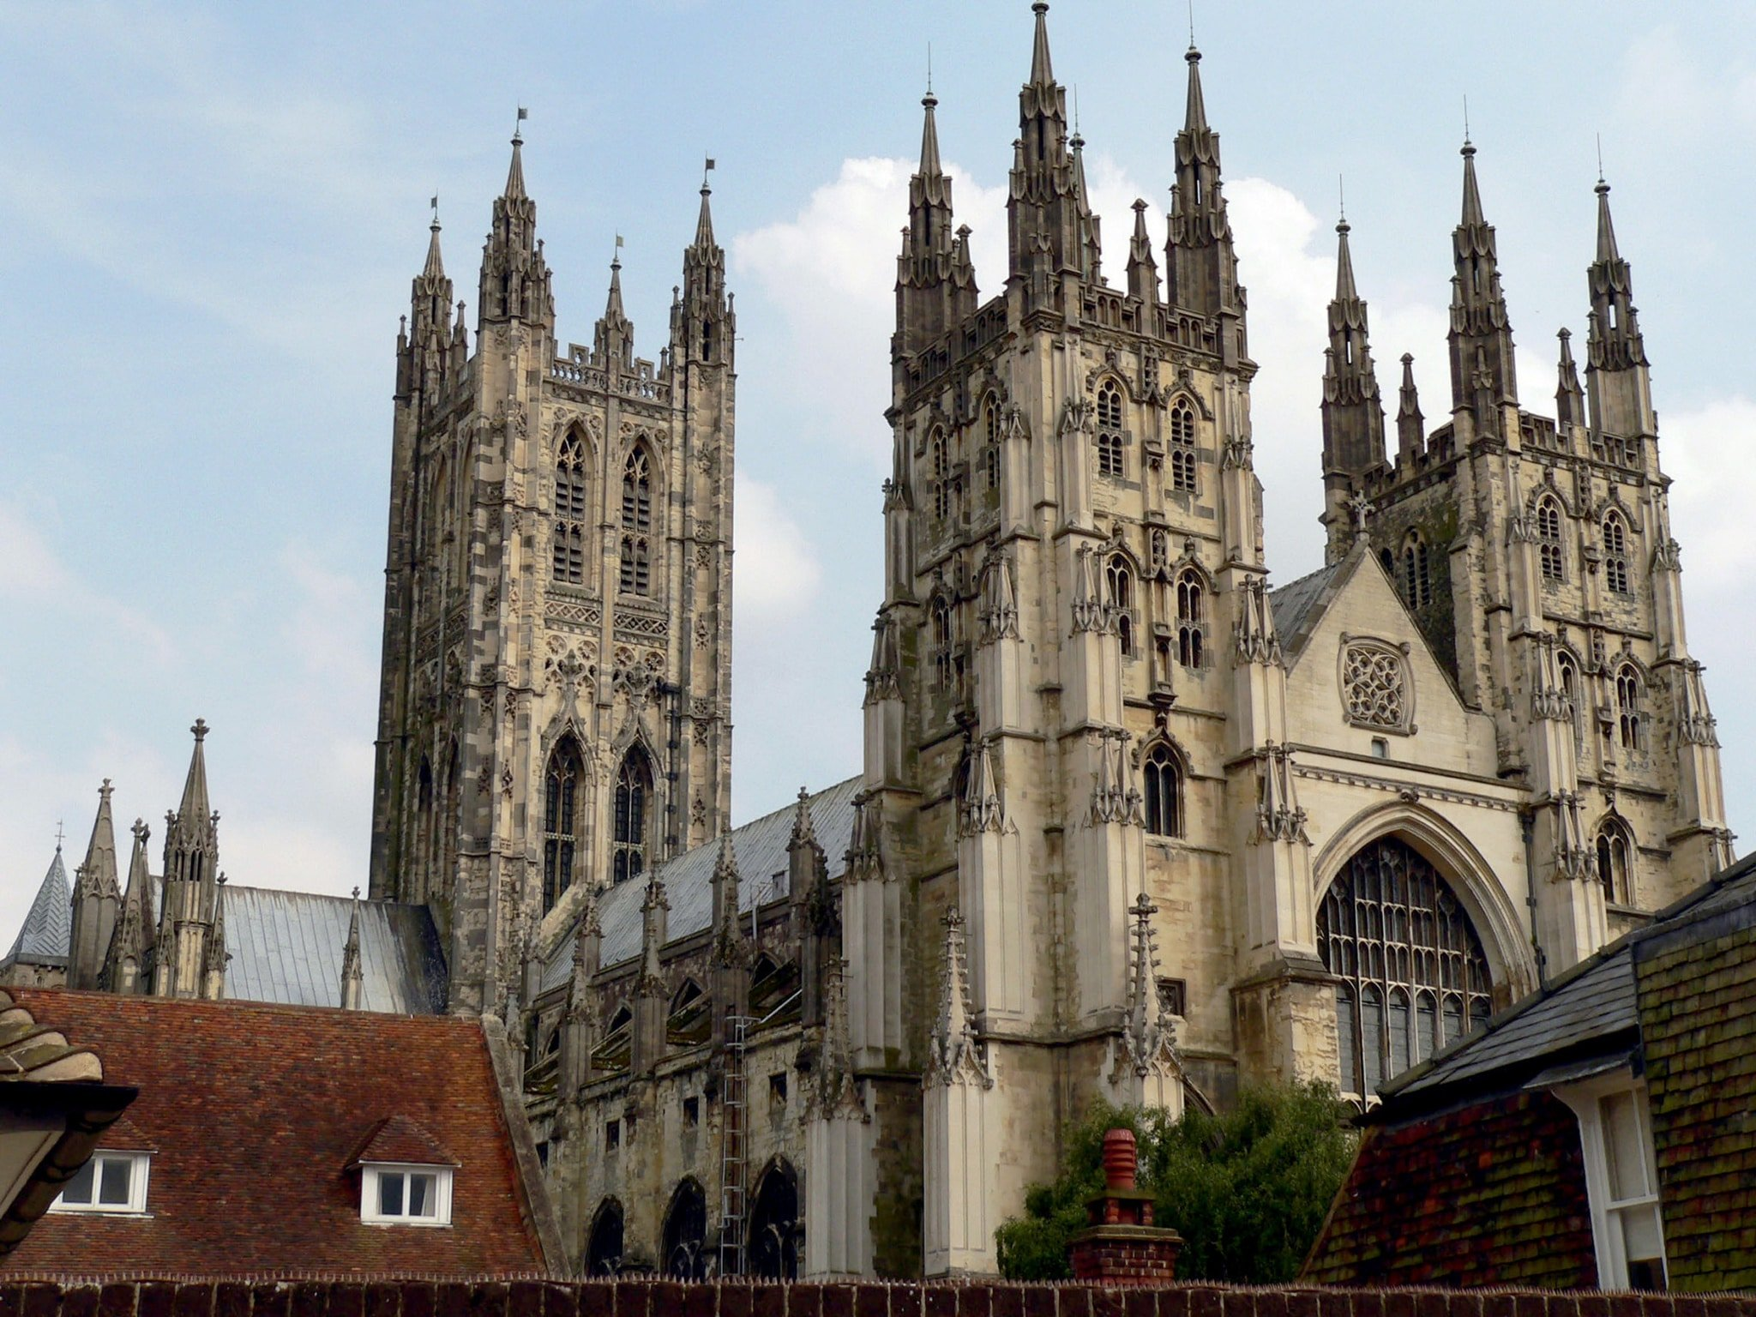
Founded: 597
Architectural styles: Romanesque, Norman, English Gotic

Slide 3
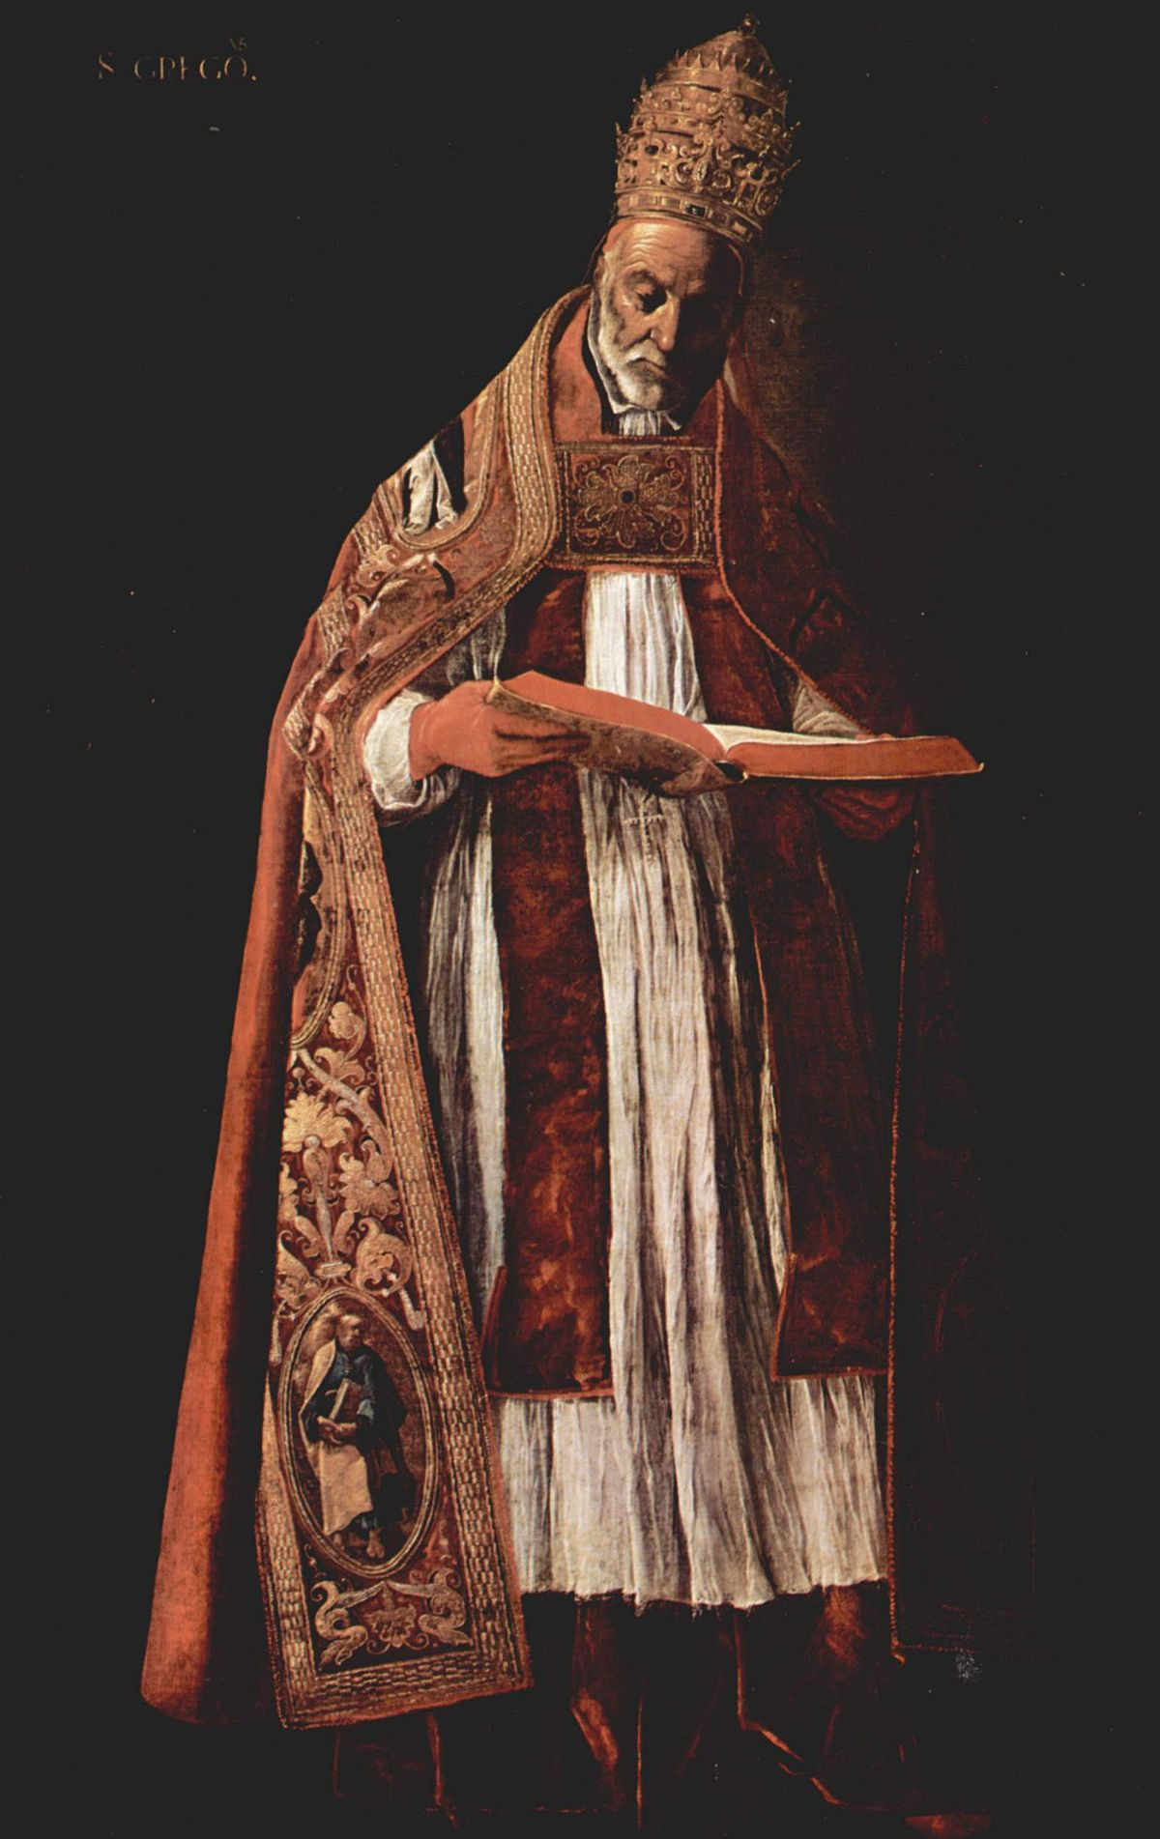
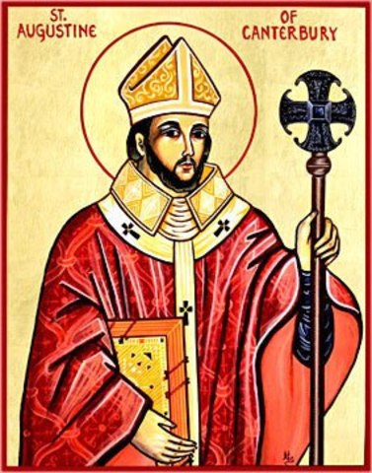
St Augustine of Canterbury
Pope Gregory I

Slide 4
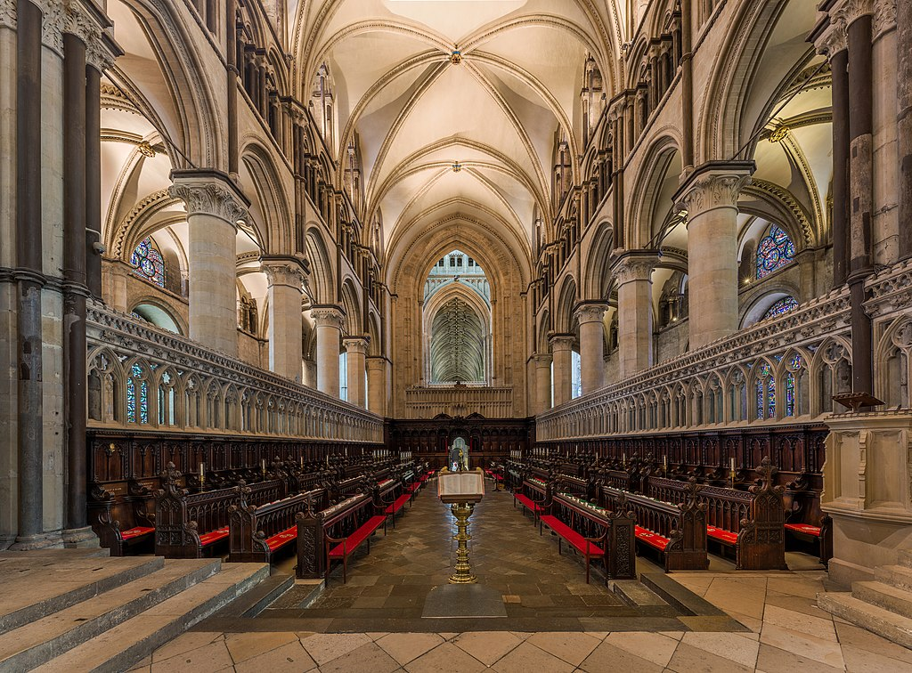
1060-70: destroyed by fire and rebuilt
“Nothing like it could be seen in England
either for the light of its glass windows,
the gleaming of its marble pavements,
or the many-colored paintings which led
the eyes to the paneled ceiling above.”
- William of Malmesbury
The 12th-century quire (reconstruction)

Slide 5
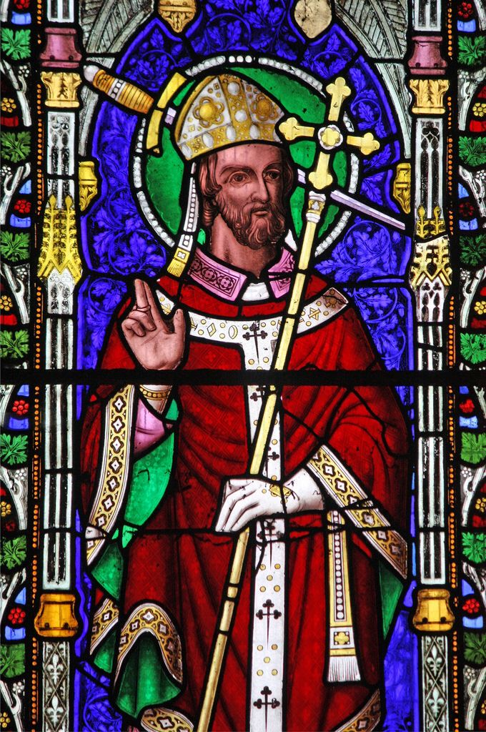
Thomas Becket, archbishop, was killed by knights of King Henry II in his own cathedral in 1170
St Thomas Becket

Slide 6
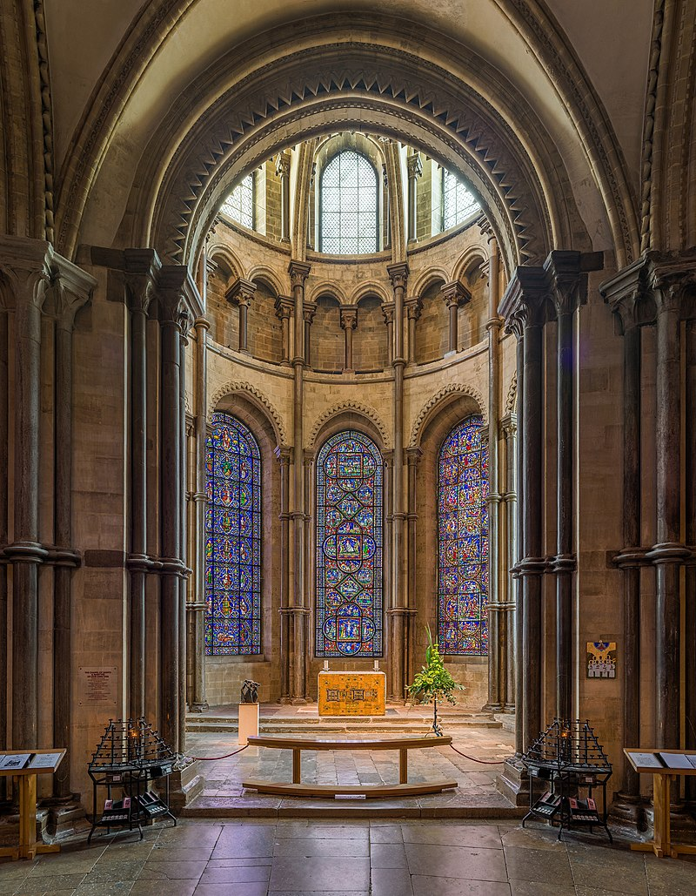
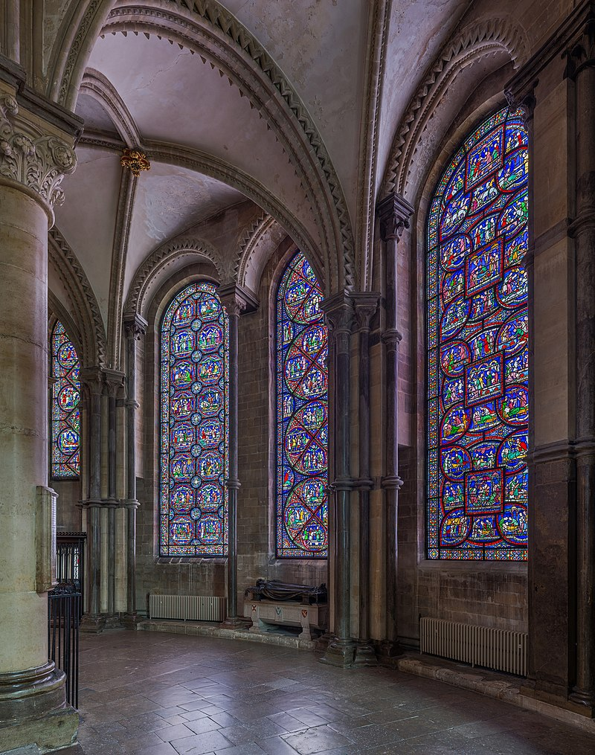
Becket’s crown (1184)
Stained glass in the Trinity Chapel

Slide 7
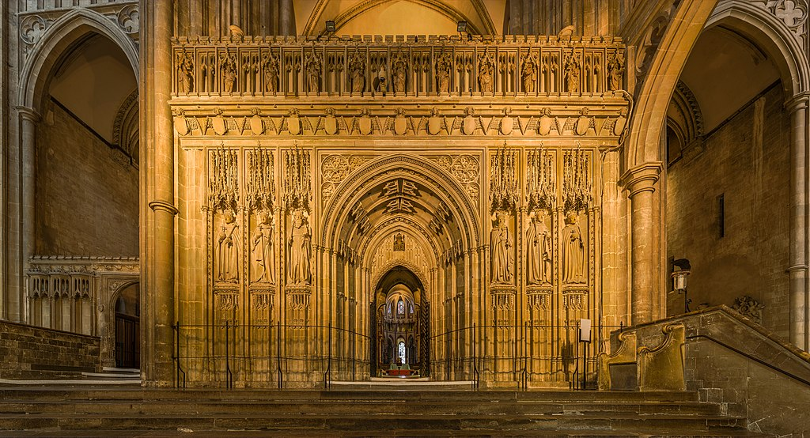
Quire screen (1786)

Slide 8
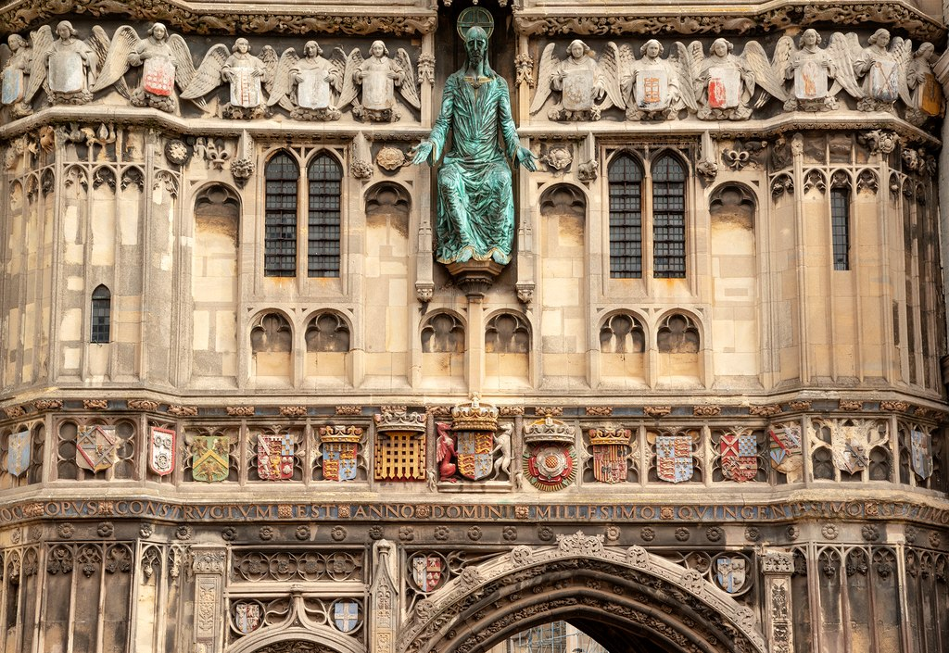
The Christchurch Gate

Slide 9
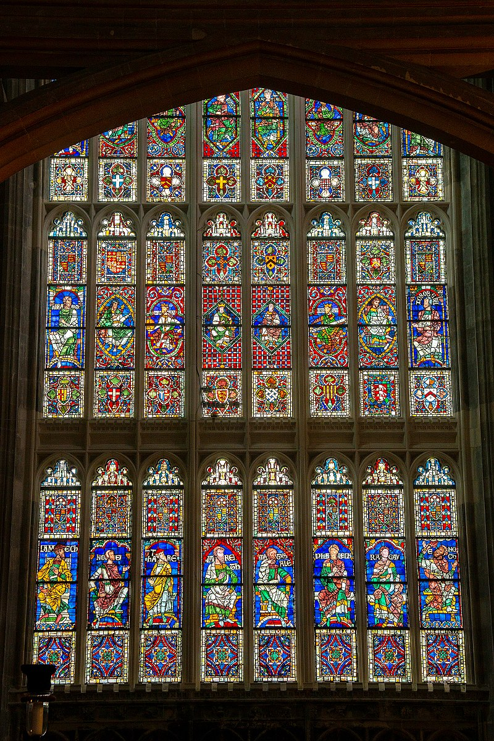
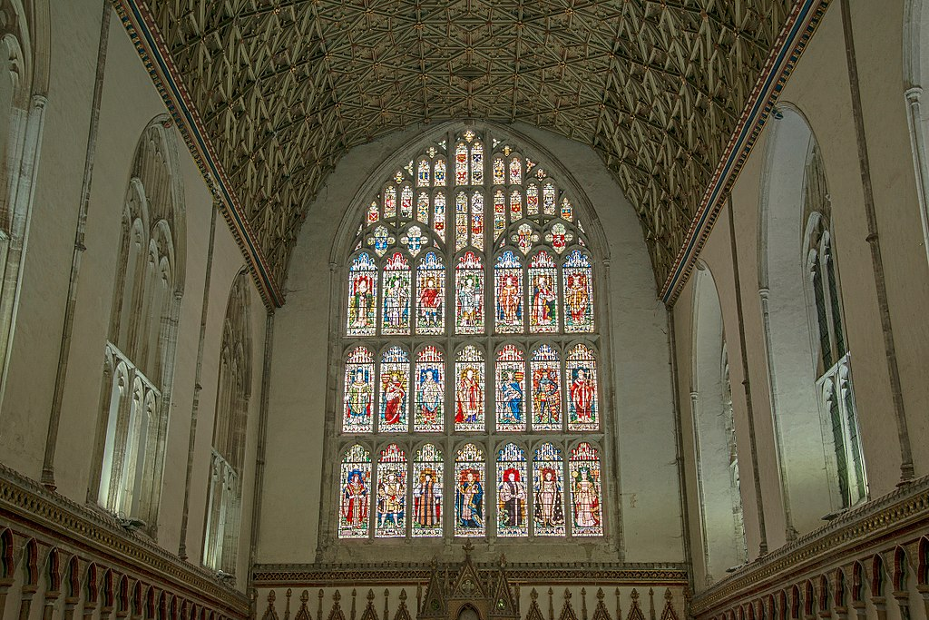
Stained-glass windows

Slide 10
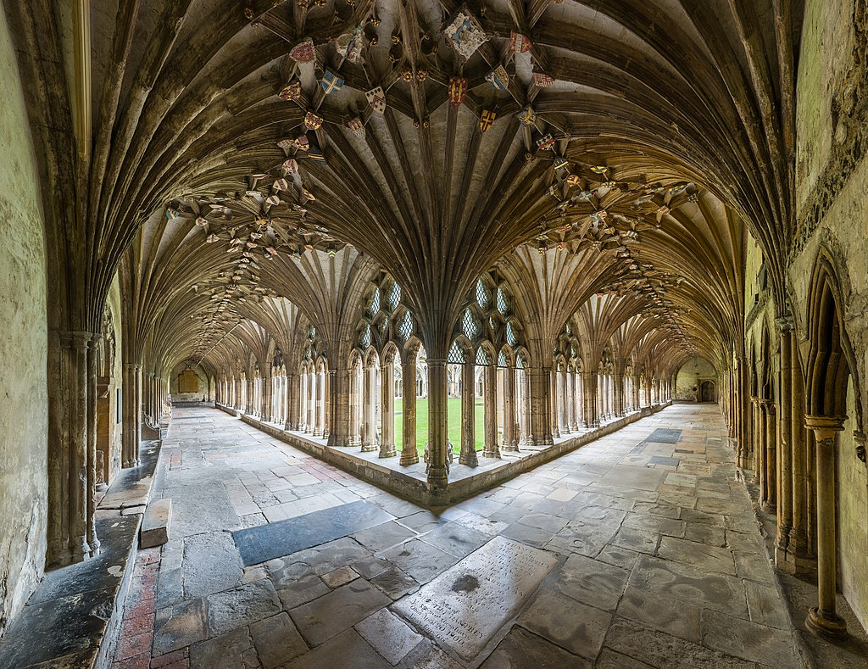
Monastic cloister

Slide 11
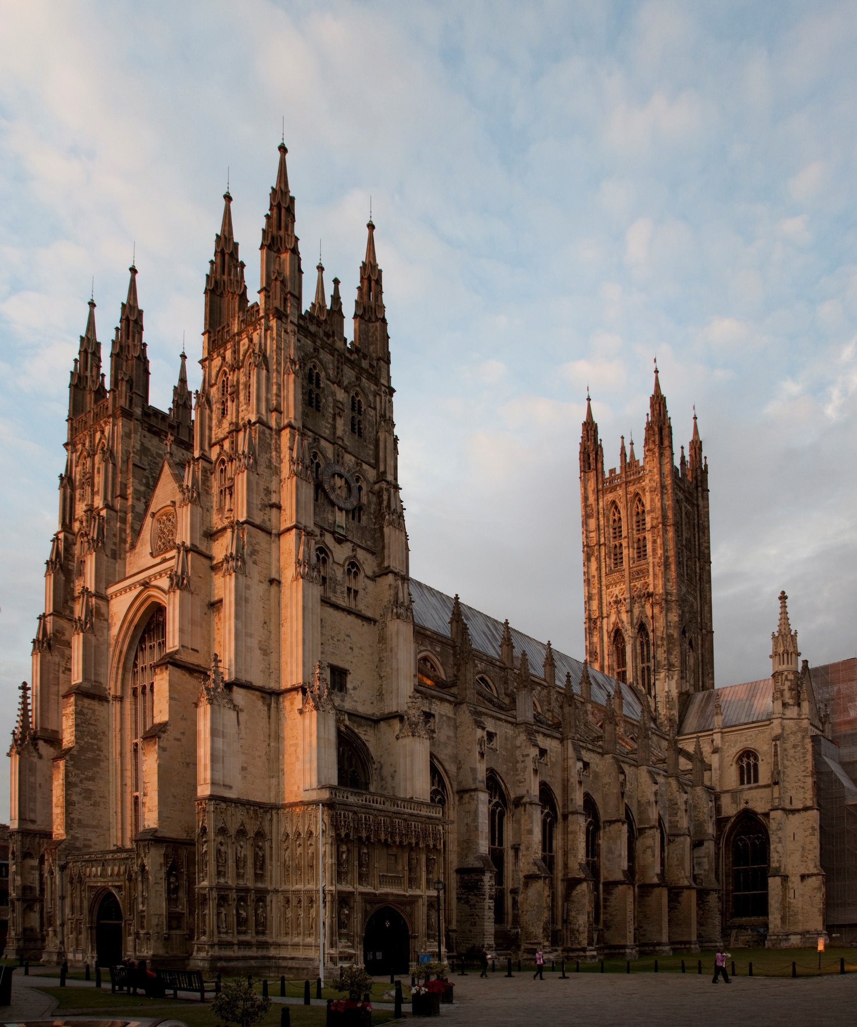
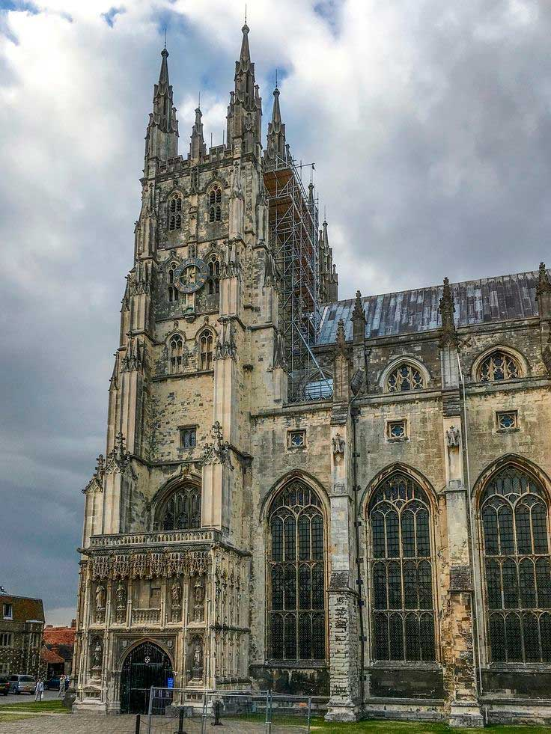

Slide 12
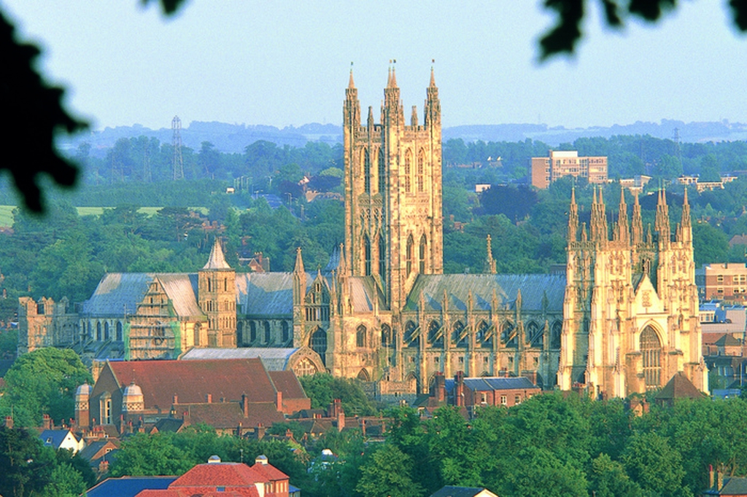

Slide 13
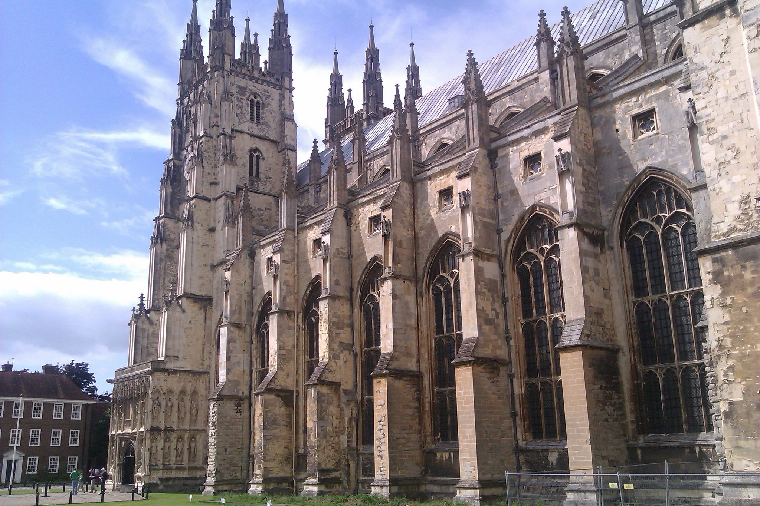

Slide 14
